Slide 1

SeatFlow — Smart Seat Booking System
A full-stack web application for batch-based office desk reservation
By: Kartikeya | Tech Stack: React · Node.js · Express · MongoDB · Tailwind CSS

Slide 2

What is SeatFlow?
The Problem
The Solution
Offices with hybrid and rotation schedules face a complex challenge: how do you fairly allocate limited desks among employees working in different batches? Manual seat allocation leads to conflicts, double bookings, and wasted seats. When someone cancels, that desk sits empty instead of being offered to others who need it.
SeatFlow is a web-based seat booking platform that manages 50 office desks across 2 employee batches. It enforces batch-specific schedules automatically and intelligently converts cancelled seats into flex opportunities.
Batch-Based Scheduling
Two Seat Types
Secure Authentication
Batch 1 (Mon–Wed), Batch 2 (Thu–Fri)
40 Regular + 10 Flex seats
JWT tokens with bcrypt hashing

Slide 3
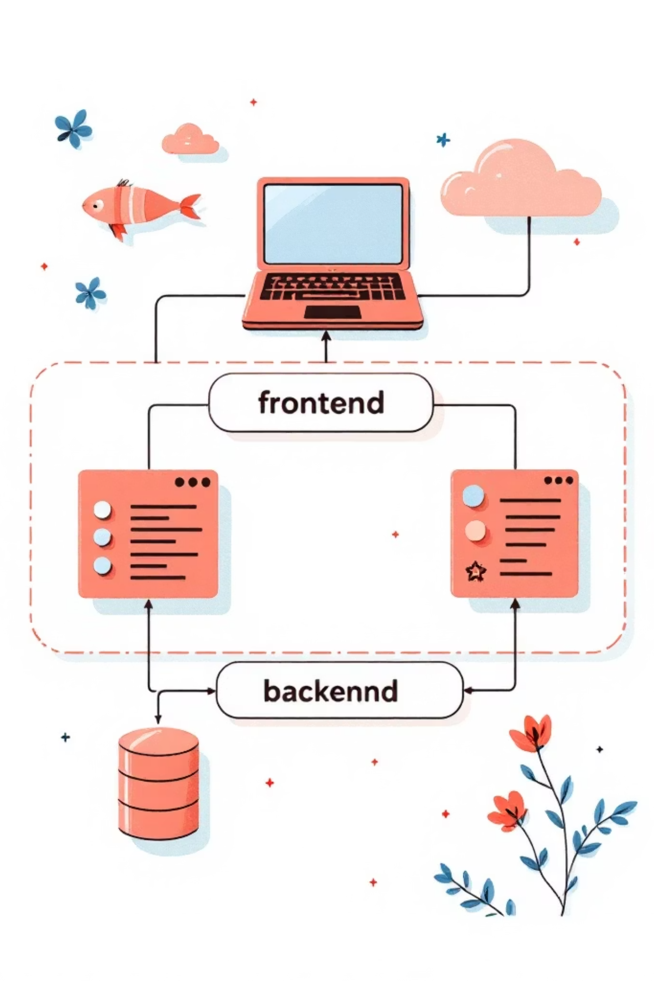
System Architecture & Tech Stack
Frontend Stack
Backend Stack
React 19 + Vite 7 for fast SPA development
React Router v6 for client-side routing
Tailwind CSS v4 for utility-first styling
Fetch API for backend communication
JWT stored in localStorage for session management
Node.js + Express 4 for REST API
MongoDB + Mongoose 8 for data modeling
JWT (jsonwebtoken) for authentication
bcryptjs for secure password hashing
Morgan for HTTP request logging
Data Models
User
Name, username, email, password, batch type
Seat
Seat number (1–50), type (regular/flex)
Booking
User reference, seat reference, date
SeatOverride
Converts cancelled regular seats to flex

Slide 4
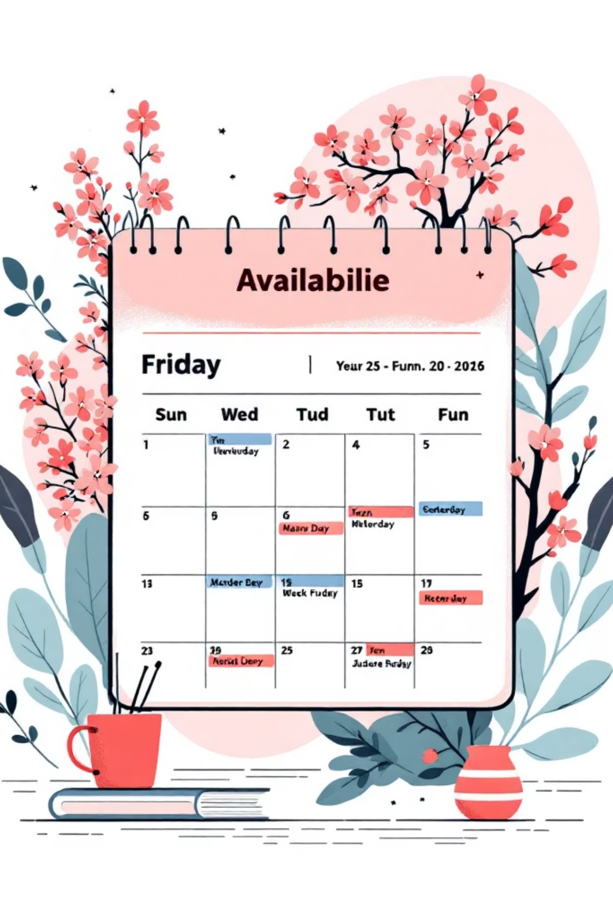
Booking Rules Engine
SeatFlow enforces sophisticated business logic to ensure fair and conflict-free seat allocation.
01
Batch-Based Seat Access
Batch 1 users access regular seats Mon–Wed; Batch 2 users access regular seats Thu–Fri. Any user can book flex seats on off-days.
02
Booking Windows
Regular seats: book 14 days ahead. Flex seats: book only tomorrow. Prevents last-minute hoarding of regular seats.
03
Cancellation Policy
Cancel before booking date only. Cancelled regular seats automatically convert to flex seats for that date.
04
Conflict Prevention
Unique database indexes ensure one seat per user per day and one user per seat per day. Weekends blocked entirely.

Slide 5
User Journey & Features
Authentication
Landing Page
Register or login with email + password. JWT token issued (24-hour validity)
System overview showing 50 seats, batch rules, and 3-step guide
Book or Release
Booking Desk
Reserve available seat or release your booking before the date
Select date and view all 50 seats in visual grid with color-coded availability
Visual Seat Status
🟢 Green
🔴 Red
Available & allowed for your batch
Already booked by someone else
🟡 Yellow
⚫ Grey
Booked by you (with release option)
Outside your booking window

